Slide 1
THE CATHOLIC UNIVERSITY OF AMERICA
Sample Undergraduate
Attendance Results
A 9-slide demonstration deck created using the CUA AI Presentation Guide workflow
Fictional data for demonstration
June 2026

Slide 2
SCOPE AND METHOD
What this sample deck measures
The deck is intentionally simple: establish scope, identify attendance patterns, and recommend actions.
Sample data only
No student records used
8,420
312
14
Enrollments reviewed
Courses included
Semester weeks
Duplicated by course enrollment
Undergraduate sections only
Fall term sample
AI guide tie-in
This slide follows the “Define” step: purpose, audience, constraints, and source material come before design.
Attendance was aggregated weekly and reviewed by college, class level, modality, and section size.
The analysis uses percent attended as the main measure, not raw headcount.
Results are directional and should be paired with advising and student-success context.
Sample undergraduate attendance results | Fictional data for demonstration
2

Slide 3
EXECUTIVE SUMMARY
Attendance is strong overall, but risk grows over the term
The sample data suggests a predictable decline that can be addressed earlier.
84%
-15 pts
18 pts
Week 5
Overall attendance rate
Change from week 1 to 14
Largest gap
Early intervention target
All included undergraduate sections
Average weekly attendance trend
In-person vs online synchronous
Before midterm decline accelerates
Main message
Attendance does not collapse suddenly. It drifts downward week by week, which creates a practical window for outreach before students fully disengage.
Sample undergraduate attendance results | Fictional data for demonstration
3

Slide 4
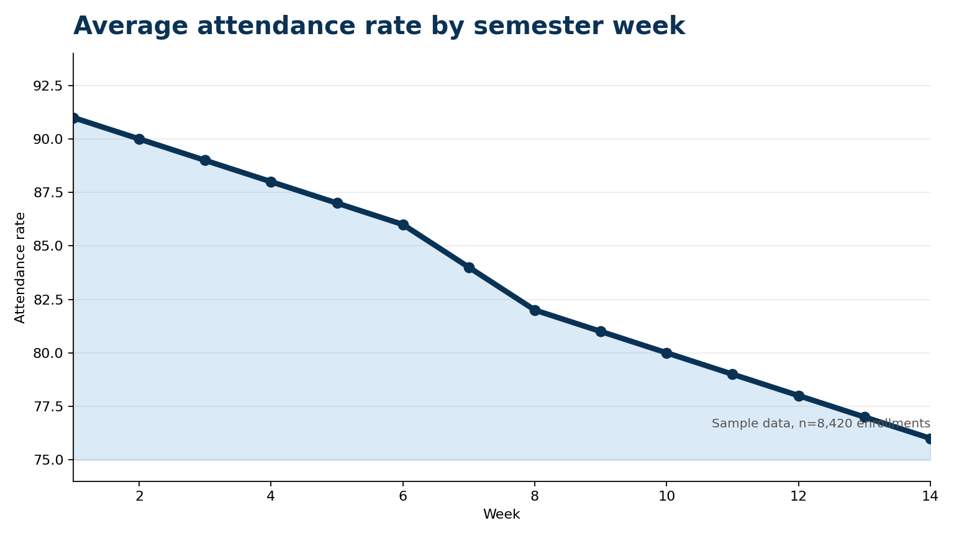
TREND OVER TIME
Attendance declines steadily across the semester
The trend line helps leaders see timing, not just the final result.
Week 5 is the ideal point for earlier outreach.
The decline begins before midterms.
Small weekly drops compound into a larger end-of-term gap.
The response should be proactive, not only end-of-term reporting.
Sample undergraduate attendance results | Fictional data for demonstration
4

Slide 5
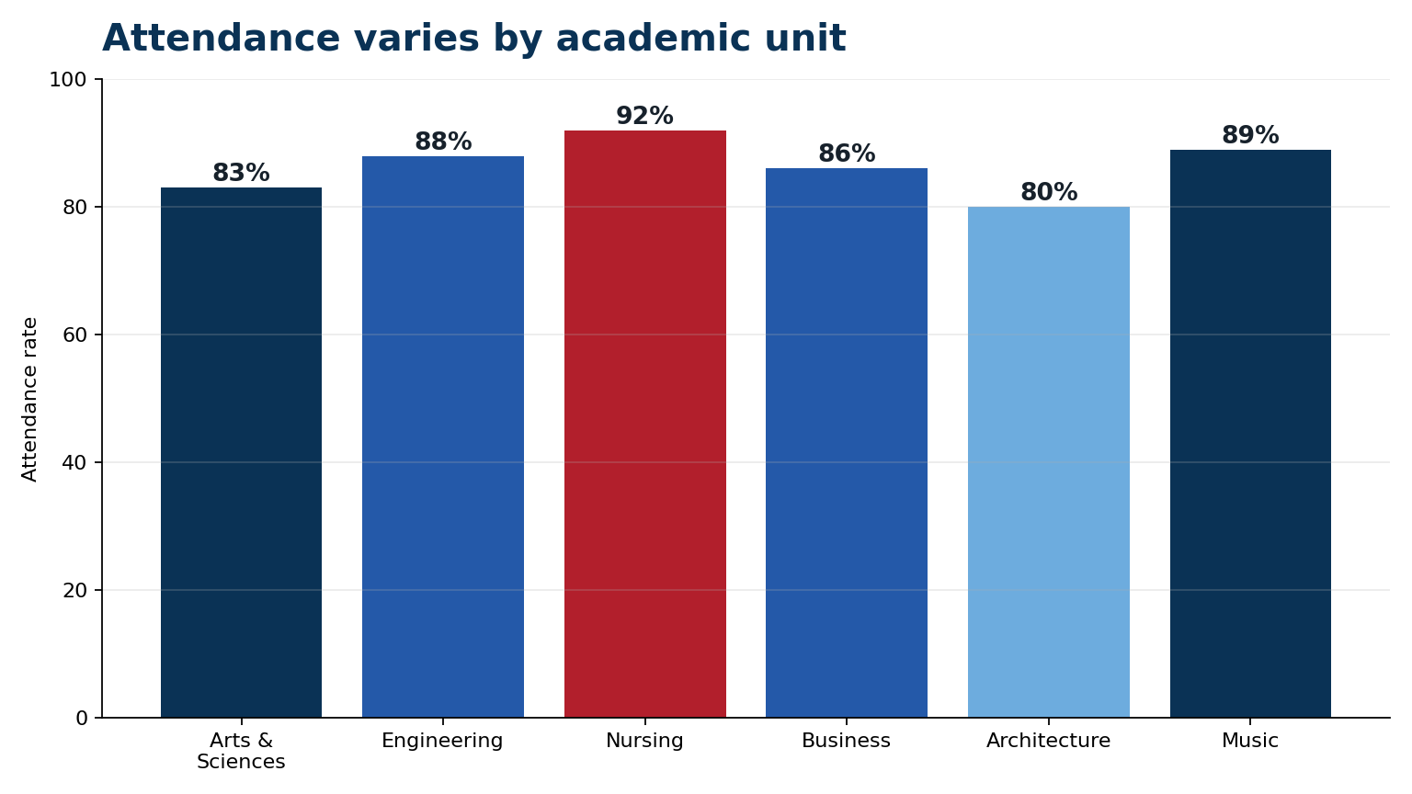
ACADEMIC UNIT VIEW
Attendance varies by college
Unit-level results can highlight where local practices or student support models are working.
How to use this view
Ask what practices explain higher attendance.
Compare similar course types before drawing conclusions.
Share promising habits across programs.
Sample undergraduate attendance results | Fictional data for demonstration
5

Slide 6
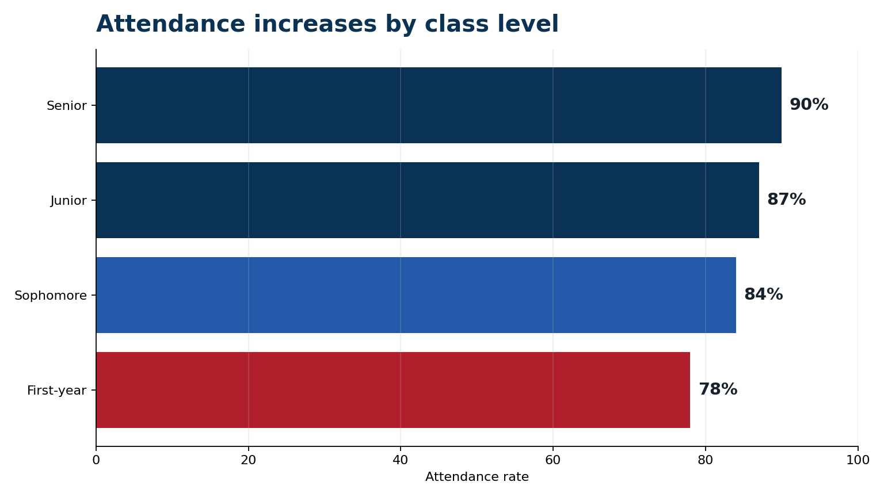
STUDENT LEVEL VIEW
First-year attendance needs the earliest attention
The class-level split suggests that new students may need clearer routines and faster outreach.
First-year rate: 78%
Interpretation
Attendance appears to improve as students become more familiar with expectations, campus routines, and available support. That makes the first six weeks especially important.
Sample undergraduate attendance results | Fictional data for demonstration
6

Slide 7
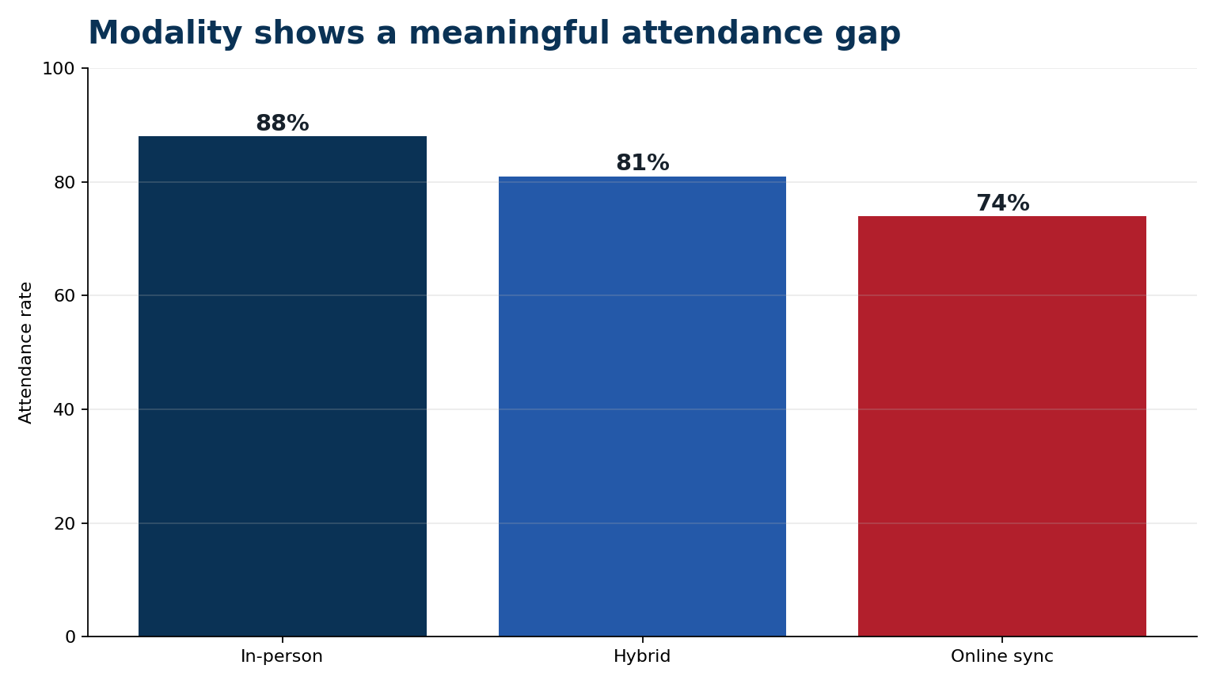
COURSE FORMAT VIEW
Modality shows a meaningful attendance gap
Format and class size should be considered when interpreting attendance results.
Important context
Online synchronous courses show the lowest sample rate.
Large sections may need different engagement strategies.
Modality should be reviewed with pedagogy, not treated as a ranking.
Design note: the chart uses real numbers from the sample dataset, while AI is used only to help interpret and explain the pattern.
Sample undergraduate attendance results | Fictional data for demonstration
7

Slide 8
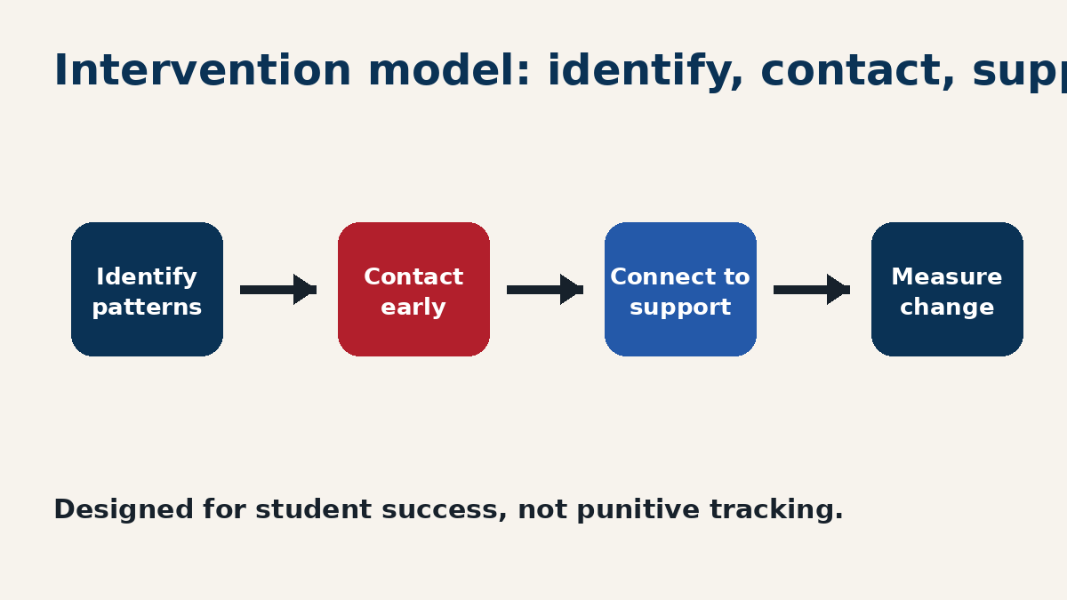
STUDENT SUCCESS RESPONSE
Turn attendance results into earlier support
The goal is a practical model for outreach, not punitive tracking.
Recommended trigger
2 missed classes
or 15% drop
Instructor notification first.
Advising contact when pattern persists.
Support referral when attendance connects to broader need.
Sample undergraduate attendance results | Fictional data for demonstration
8

Slide 9
NEXT STEPS
Create a repeatable attendance review cycle
Confirm definitions
1
Agree on attendance measure, included courses, and reporting cadence.
AI guide connection
The deck follows the guide’s sequence: define, outline, draft, visualize, and review. Branding is kept consistent through repeated layouts, CUA colors, concise copy, and verified sample data.
Pilot early alerts
2
Start with first-year and high-risk gateway courses.
Build dashboard
3
Create a consistent weekly view for academic and student-success leaders.
Review outcomes
4
Measure whether outreach improves attendance and persistence.
Sample undergraduate attendance results | Fictional data for demonstration
9

